Slide 1
Introduction to Statistics
Summer School UNSW 2019: Research Lab 4
Jennifer Sloane

Slide 2
Psychology as a Science
The SCIENTIFIC study of behavior and the physiological and cognitive processes that underlie it
Goals of psychology:
Define a behavior
Explain behavior
Predict behavior
Control behavior
But…how do we do this?

Slide 3
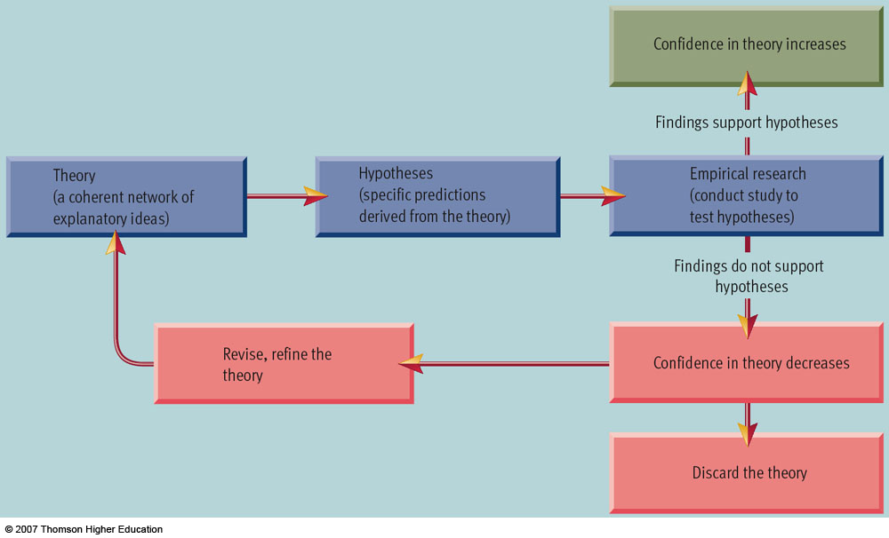
Scientific Method

Slide 4
5 Steps of the Scientific Method
Formulate a testable hypothesis
Select an appropriate research method to design the study
Experiments, case studies, naturalistic observations, surveys
Collect the data
Analyze data and draw conclusion
Report findings

Slide 5
Correlational design/ Descriptive Statistics

Slide 6
Statistics
Statistics: using mathematics to organize, summarize, and interpret numerical data
Descriptive statistics: organizing and summarizing data
Tables, charts, averages

Slide 7
Descriptive/Correlational Methods: all about relationships
When we cannot manipulate the variables, we can use…
Naturalistic observation
Case studies
Surveys
Correlation does not equal causation
These methods do allow researchers to describe patterns of behavior and discover links or associations between variables

Slide 8
How to tell if a treatment actually worked
Never say a study proved something
We are making inferences because we don’t have data from the entire population
In psychology, we use 95% confidence interval
That means we likely make an error 5% of the time!

Slide 9
Descriptive Statistics: Correlation
When two variables are related to each other, they are correlated
Correlation is expressed as a number between -1 and +1
Numbers close to +1 means a positive relationship
Numbers close to -1 means a negative relationship
Which relationship is stronger? .55 or -.75
Notes:
Students seemed to have a good understanding of correlations, so went through this very quickly

Slide 10
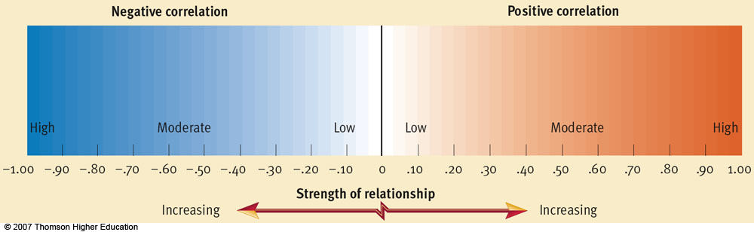

Slide 11
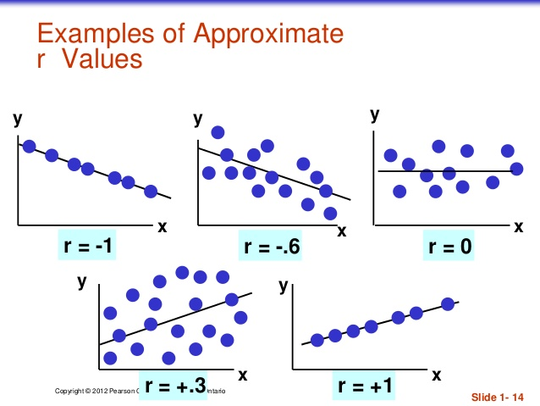

Slide 12
Descriptive Statistics: Correlation
The closer the coefficient is to +1 or -1, the stronger the relationship between the variables
What does a correlation of 0 mean?
No relationship

Slide 13
Positive Correlations
0 to +1
Two variables co-vary in the SAME direction
* The more you study, the better your grades will be
studying, grades
* The less you smoke, the lower your risk for lung cancer
smoking, lung cancer

Slide 14
If positive correlations co-vary in the SAME direction, what pattern do you think negative correlations will have?

Slide 15
Negative Correlation
0 to -1
Two variables co-vary in OPPOSITE directions
* The more you exercise, the less you weigh
exercise, weight
* The less you spend, the more you save
spending, saving

Slide 16
Statistics Recap
subject | score
1 | 10
2 | 10
3 | 15
4 | 15
5 | 20
6 | 25
7 | 30
8 | 30
9 | 30
10 | 85
Measure of central tendency = typical or average score in a distribution
Mean: arithmetic average of scores
Median: score falling in the exact center
Mode: most frequently occurring score
Notes:
Mean = 27
Median = 20+25/2 = 22.5
Mode = 30

Slide 17
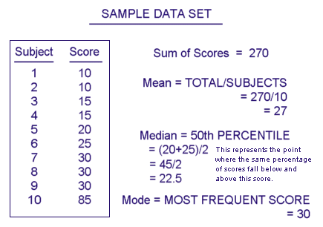

Slide 18
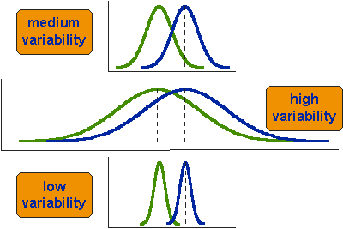
Descriptive Statistics: Variability/Variance
Variability = how much the scores vary from each other and from the mean
Standard deviation = numerical depiction of variability
High variability in data set = high standard deviation
Low variability in data set = low standard deviation

Slide 19
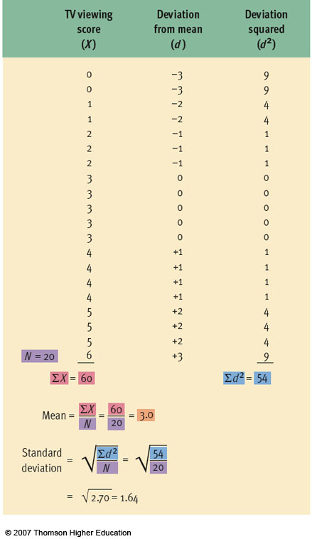
Finding variance:
Find mean = 3
Find deviation from the mean for each score (column 2)
Square deviations (column 3)
Sum squared deviations = 54
Variance = squared deviations / N = 54/20
-3
^2
-3
^2
-3
^2
-3
^2
Finding standard Deviation:
Take square root of variance
Answer: 1.64
-3
^2

Slide 20
Experimental design/ inferential statistics

Slide 21
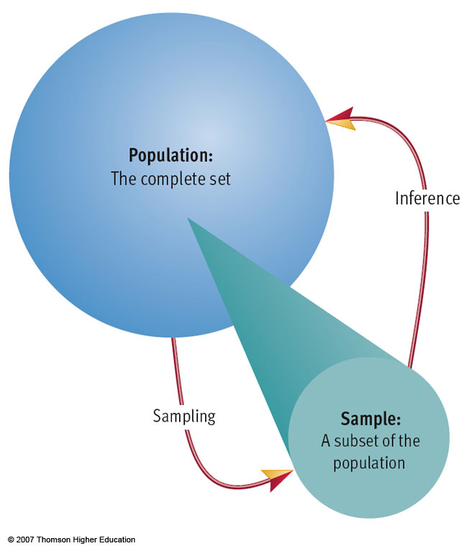
Conducting an Experiment: Sampling
Population
Entire group you’re interested in
Sample
Subset of population
Sample should be RANDOM and representative

Slide 22

Statistics
Statistics: using mathematics to organize, summarize, and interpret numerical data
Descriptive statistics: organizing and summarizing data
Tables, charts, averages
Inferential statistics: Using sample data to draw conclusions about the population

Slide 23
Can you define…
Experiment?
Variable?
Independent variable?
Dependent variable?
Notes:
Skimmed through these slides because students were familiar with all of these terms

Slide 24
Vocabulary Defined
Experiment = manipulation of one variable under controlled conditions to observe any changes in a 2nd variable as a result
Cause and effect
Variable = a measurable condition/characteristic

Slide 25
Vocabulary Defined
Independent variable (IV) = manipulated variable (e.g. drug/placebo)
X = independent variable/cause
Dependent variable (DV) = variable affected by manipulation (i.e., what you measure)
How does the IV affect the DV
Y = dependent variable/effect

Slide 26
Example
We want to find out how a crowd’s noise level will effect the football team’s performance
Independent Variable?
Crowd’s Noise Level
Dependent Variable?
Football Team’s Performance
*Extraneous Variable?
A particular team is playing at home and is more confident in the setting
Notes:
Went through this example together

Slide 27
Activity
Notes:
Skipped the design your own experiment activity

Slide 28
https://www.quia.com/pop/184568.html?AP_rand=653375717
Notes:
Skipped this

Slide 29
Conducting an Experiment: Assigning Groups
Experimental group
Receives treatment in regards to IV
Control group
Does NOT receive treatment to IV
Random assignment
All participants have an equal chance of being assigned to any group

Slide 30
Advantages and Disadvantages of Experimental Research
Advantages:
Causal conclusions can be drawn
Weaknesses:
Artificial nature of experiment – ex: social desirability effect
Ethical issues – ex. You cannot conduct an experiment on domestic violence because you cannot ethically allow someone to be abused
Practical issues – ex. You can’t manipulate certain variables like age, gender, or height

Slide 31
Statistical testing
Researchers set a significance level (usually 0.05) for each statistical test they conduct
If p <= 0.05, then you reject the null hypothesis (H₀) and accept the alternative hypothesis (H₁)
If p > 0.05, then you accept the null hypothesis
Degrees of freedom (df) = how we account for variation due to error
Specifies how many values vary within a statistical test

Slide 32
Statistical testing
 | H₀ is actually:
 | True | False
Reject H₀ | Type I Error | Correct
Accept H₀ | Correct | Type II Error
Type I Error: Rejecting a true null hypothesis (“false positive”)
Type II Error: Non-rejection of a false null hypothesis (“false negative”)

Slide 33
Statistical testing
Inferential statistics: used to test mean differences between groups
1) T-test: when testing between 2 groups
Report t statistic (critical value) based on df and alpha level
2) Analysis of Variance (ANOVA): when testing between more than 2 groups
Report F statistic (critical value) based on df and alpha level
3) Chi Square: testing relationship between categorical variables

Slide 34
Jamovi

Slide 35
Statistical analyses using jamovi
Open up Jamovi
Load in your dataset
Is there any missing data?
Are there any variables you don’t understand?
Think about your primary hypothesis: what variables are you interested in?
If you’re using questionnaires, do you have to reverse code any items? If so, which items?
What descriptive statistics would be helpful?
How do you want to visualize your data?
What inferential statistics do you think you should do?
Notes:
At this stage because we continued working on pre-registration today, we did not have the raw data ready for the students to look at
So instead, we went through some pilot data and looked at the raw data and reversed coded a couple of items together.
Need to print out the scales/surveys for students

Slide 36
My research

Slide 37
CRT Questions
Let's pretend you're running a race. You pass the person in second place. What place are you now in?
A farmer had 15 sheep. Many of the sheep got very sick. All but 8 died. How many sheep are left?
Imagine there are three elves. Together, they can wrap three toys in one hour. How many elves are needed to wrap six toys in two hours?
In an athletics team, tall members are three times more likely to win a medal than short members. This year the team has won 60 medals so far. How many of these have been won by short athletes?
Jerry received the 15th highest mark in the class. Jerry also received the 15th lowest mark in the class. How many students are there in the class?
Notes:
Didn’t have time to go through my research

Slide 38
Decoy Questions
A ship had 500 crates of oranges. At the first stop, 100 crates were unloaded. At the second stop, 200 more were unloaded. How many crates of oranges were left after the second stop?
Sara, Emma, and Sophia embark on a river trip. Each of them brings one item: a kayak, a cooler of sandwiches, and a bag of apples. Sara brought the apples and Emma didn't bring anything edible. What did Sophia bring?
An expedition on a mountain climbing trip was traveling with eleven horse packs. Each horse can carry only three packs. How many horses does the expedition need?
A mechanic shop had five silver cars, two red cars, and one blue car in the garage. During the day, three silver cars and one red car were picked up, and one black car was dropped off. How many silver cars were in the garage at the end of the day?
This question is not like the rest. It is only to check that you are not a robot and paying attention. Please select 3 and then absolutely certain

Slide 39
Research Aim:
Use the CRT to study the role of interruptions and time pressure on the balance of intuitive and analytic kinds of thinking.
Question #1:
Are people even more likely to make intuitive and incorrect responses when interrupted or under time pressure?
Question #2:
How well calibrated are people with respect to accuracy and confidence?

Slide 40
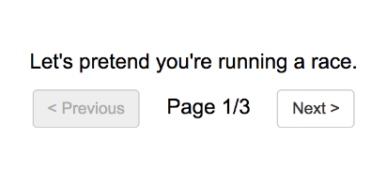
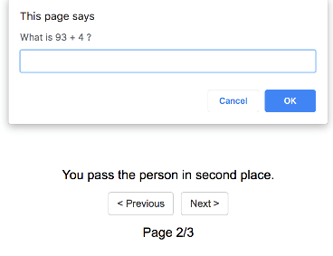
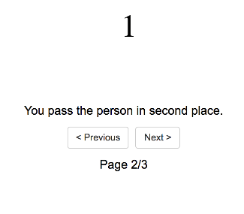
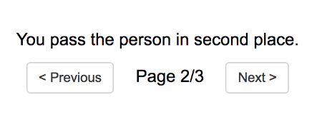
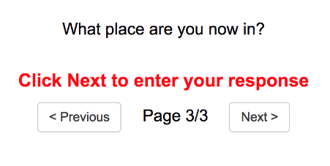
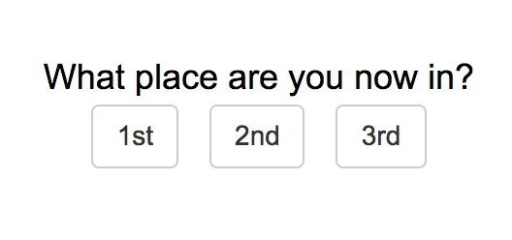
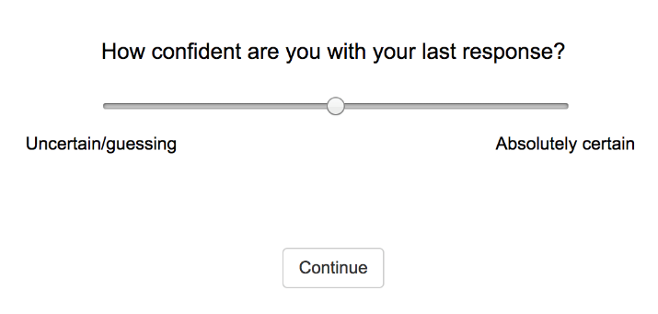
Methods
Baseline
Time
Pressure
Interruption
Always MC with 3 options

Slide 41
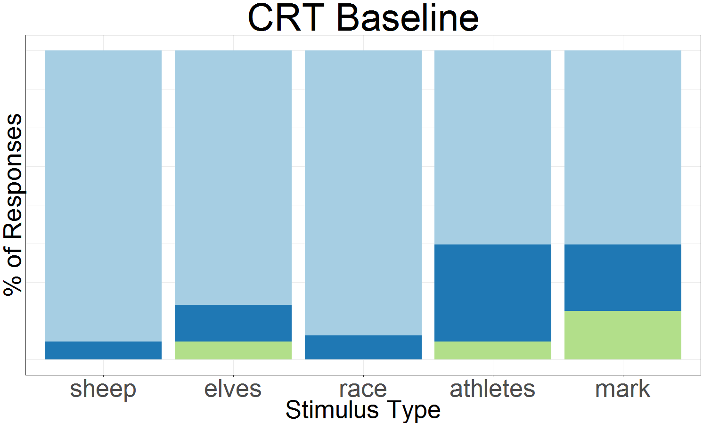
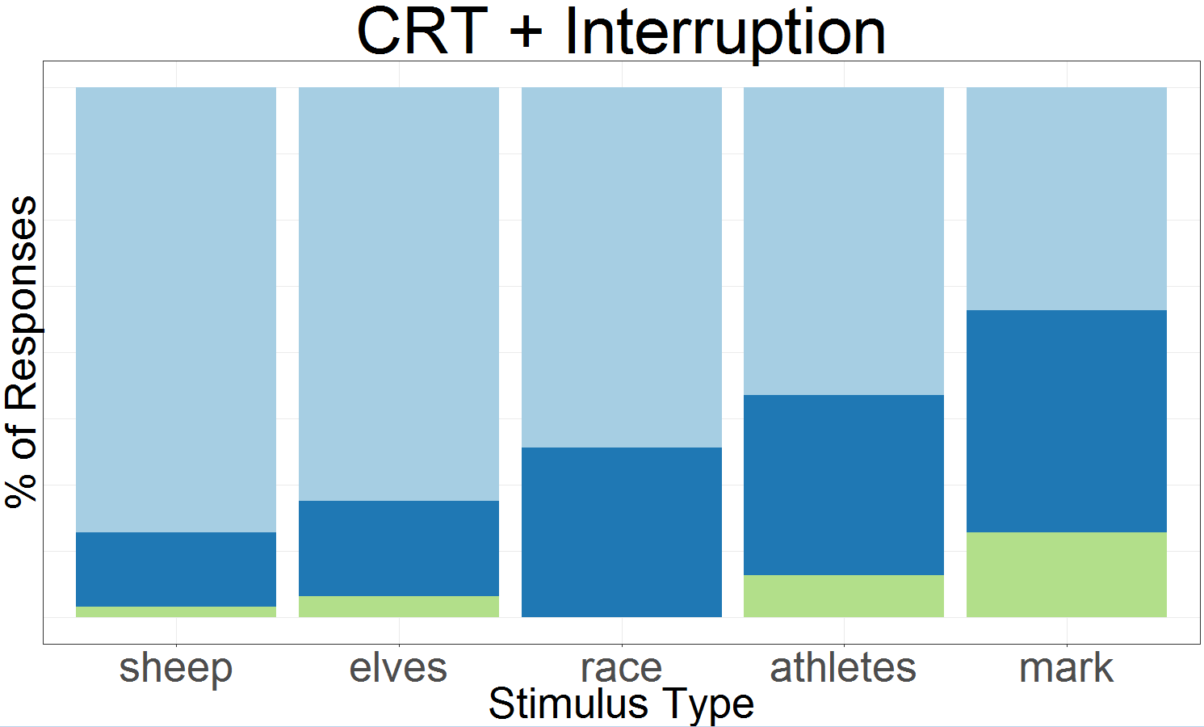
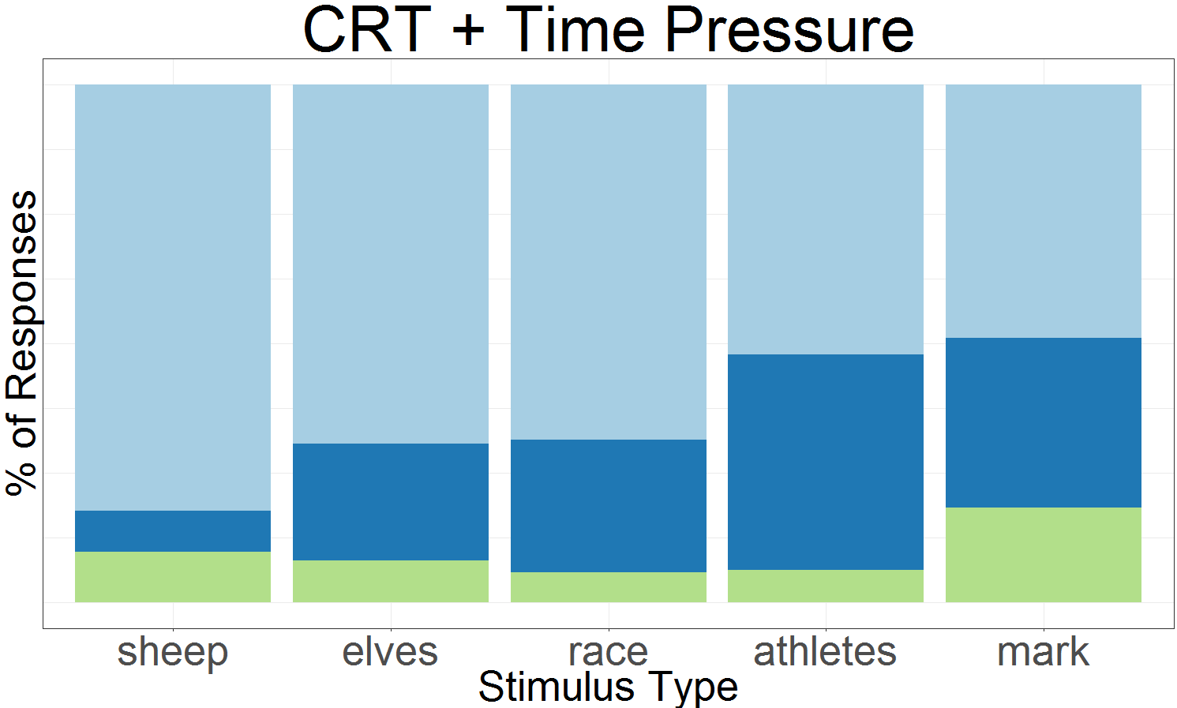
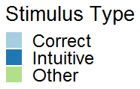
Results
Question #1: Are people even more likely to make intuitive and incorrect responses when interrupted or under time pressure?

Slide 42
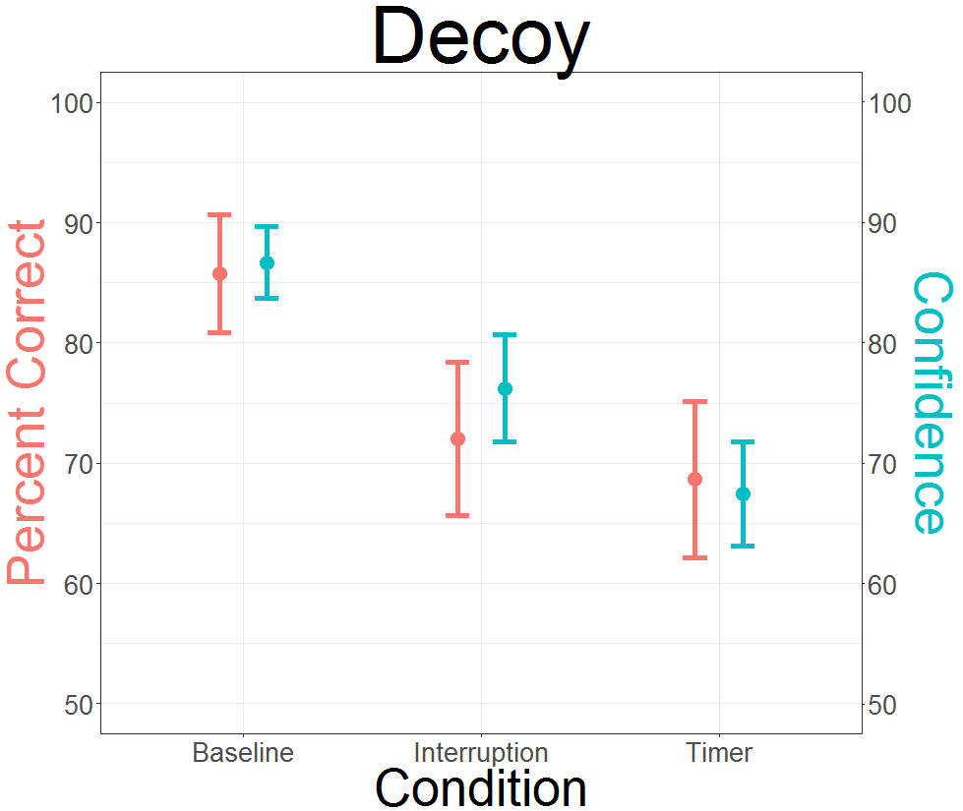
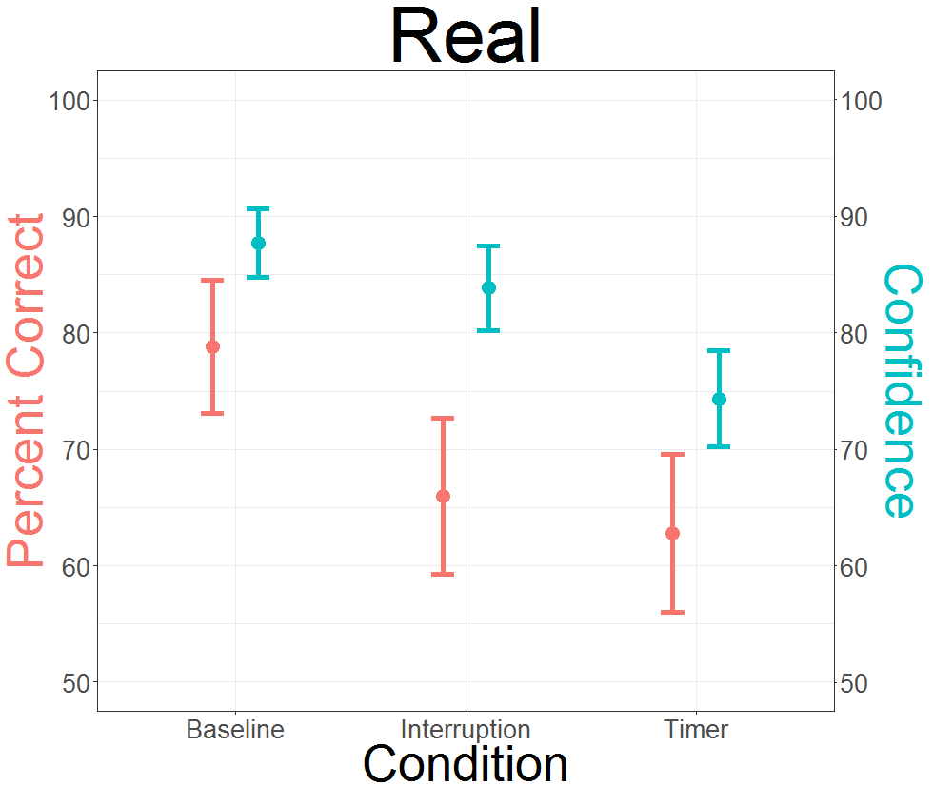

Results
Question #2: How well calibrated are people with respect to accuracy and confidence?

Slide 43
Conclusions
People made more incorrect and intuitive responses (and more mistakes in general) when interrupted and under time pressure
Decoy questions
Interruptions and time pressure resulted in lower accuracy and lower confidence compared to baseline
CRT questions
When interrupted: Accuracy, but not confidence, decreased
When under time pressure: accuracy and confidence decreased
Interruptions and time pressure influence the processing of information and give us insight into the type and incidence of errors in decision making

